Slide 1
Hierarchical Attention Networks From Scratch
Shang Gao

Slide 2
Background
National Cancer Institute has asked Oak Ridge National Lab to develop a program that can automatically classify cancer pathology reports
Pathology reports are what doctors write up when they diagnose cancer, and NCI uses them to calculate national statistics and track health trends
Challenges:
Different doctors use different terminology to label the same types of cancer
Some diagnoses may reference other types of cancer or other organs that are not the actual cancer being diagnosed
Typos
Task: given a pathology report, teach a program to find the type of cancer, location of cancer, histological grade, etc

Slide 3
Background
The performance of various different classifiers were tested:
Traditional machine learning classifiers: Naive Bayes, Logistic Regression, Support Vector Machines, Random Forests, and XG-Boost
Traditional machine learning classifiers require manually defined features, such n-grams and tf-idf
Deep learning methods: recurrent neural networks, convolutional neural networks, and hierarchical attention networks
Given enough data, deep learning methods can learn their own features, such as which words or phrases are important
The Hierarchical Attention Network is a relatively new deep learning model that came out last year and is one of the top performers

Slide 4
Overview
Review of Recurrent Neural Networks
Advanced RNN Architectures
Long-Short-Term-Memory
Gated Recurrent Units
RNNs for Natural Language Processing
Word Embeddings
NLP Applications
Attention Mechanisms
Hierarchical Attention Networks

Slide 5

Recurrent Neural Networks
Recurrent Neural Networks are designed for time-series data (e.g. weather, stock market data, speech audio, natural language)
In a regular feedforward network, each neuron takes in inputs from the neurons in the previous layer, and then pass its output to the neurons in the next layer
The neurons at the end make a classification based only on the data from the current input

Slide 6

Recurrent Neural Networks
In a recurrent neural network, each neuron takes in data from the previous layer AND its own output from the previous timestep
The neurons at the end make a classification decision based on NOT ONLY the input at the current timestep BUT ALSO the input from all timesteps before it
Recurrent neural networks can thus capture patterns over time

Slide 7
Recurrent Neural Networks
In the example below, the neuron at the first timestep takes in an input and generates an output
The neuron at the second timestep takes in an input AND ALSO the output from the first timestep to make its decision
The neuron at the third timestep takes in an input and also the output from the second timestep (which accounted for data from the first timestep), so its output is affected by data from both the first and second timestep

Slide 8

Recurrent Neural Networks
Traditional Neuron: output = sigmoid(weights * input + bias)
Recurrent Neuron: output = sigmoid(weights1 * input + weights2 * previous_output + bias) or output = sigmoid(weights * concat(input, previous_output) + bias)

Slide 9
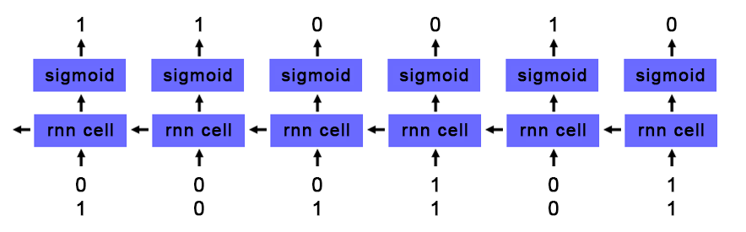
Toy RNN Example Adding Binary
At each timestep, RNN takes in two values representing binary input
At each timestep, RNN outputs the sum of the two binary values taking into account any carryover from previous timestep

Slide 10
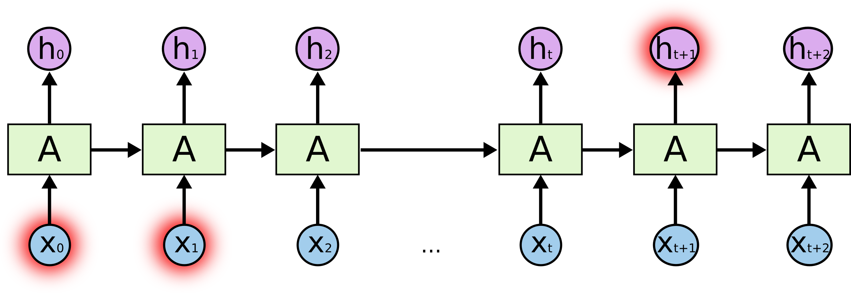
Problems with Basic RNNs
In a basic RNN, new data is written into each cell at every timestep
Data from timesteps very early on get diluted because they are written over so many times
In the example below, data from the first timestep is read into the RNN
At each subsequent timestep, the RNN factors in data from the current timestep
By the end of the RNN, the data from the first timestep has very little impact on the output of the RNN

Slide 11
Problems with Basic RNNs
Basic RNN cells can’t retain information across a large number of timesteps
In practice, RNNs can lose data in as few as 3-5 timesteps
This is causes problems on tasks where information needs to be retained over a long time
For example, in natural language processing, the meaning of a pronoun may depend on what was stated in a previous sentence

Slide 12

Long Short Term Memory
Long Short Term Memory cells are advanced RNN cells that address the problem of long-term dependencies
Instead of always writing to each cell at every time step, each unit has an internal ‘memory’ that can be written to selectively

Slide 13

Long Short Term Memory
Input from the current timestep is written to the internal memory based on how relevant it is to the problem (relevance is learned during training through backpropagation)
If the input isn’t relevant, no data is written into the cell
This way data can be preserved over many timesteps and be retrieved when it is needed

Slide 14

Long Short Term Memory
Movement of data into and out of an LSTM cell is controlled by “gates”
The “forget gate” outputs a value between 0 (delete) and 1 (keep) and controls how much of the internal memory to keep from the previous timestep
For example, at the end of a sentence, when a ‘.’ is encountered, we may want to reset the internal memory of the cell

Slide 15

Long Short Term Memory
The “candidate value” is the processed input value from the current timestep that may be added to memory
Note that tanh activation is used for the “candidate value” to allow for negative values to subtract from memory
The “input gate” outputs a value between 0 (delete) and 1 (keep) and controls how much of the candidate value add to memory

Slide 16

Long Short Term Memory
Combined, the “input gate” and “candidate value” determine what new data gets written into memory
The “forget gate” determines how much of the previous memory to retain
The new memory of the LSTM cell is the “forget gate” * the previous memory state + the “input gate” * the “candidate value” from the current timestep

Slide 17

Long Short Term Memory
The LSTM cell does not output the contents of its memory to the next layer
Stored data in memory might not be relevant for current timestep, e.g., a cell can store a pronoun reference and only output when the pronoun appears
Instead, an “output” gate outputs a value between 0 and 1 that determines how much of the memory to output
The memory goes through a final tanh activation before being passed to the next layer

Slide 18

Gated Recurrent Units
Gated Recurrent Units are very similar to LSTMs but use two gates instead of three
The “update gate” determines how much of the previous memory to keep
The “reset gate” determines how to combine the new input with the previous memory
The entire internal memory is output without an additional activation

Slide 19
LSTMs vs GRUs
Greff, et al. (2015) compared LSTMs and GRUs and found they perform about the same
Jozefowicz, et al. (2015) generated more than ten thousand variants of RNNs and determined that depending on the task, some may perform better than LSTMs
GRUs train faster than LSTMs because they are less complex
Generally speaking, tuning hyperparameters (e.g. number of units, size of weights) will probably affect performance more than picking between GRU and LSTM

Slide 20
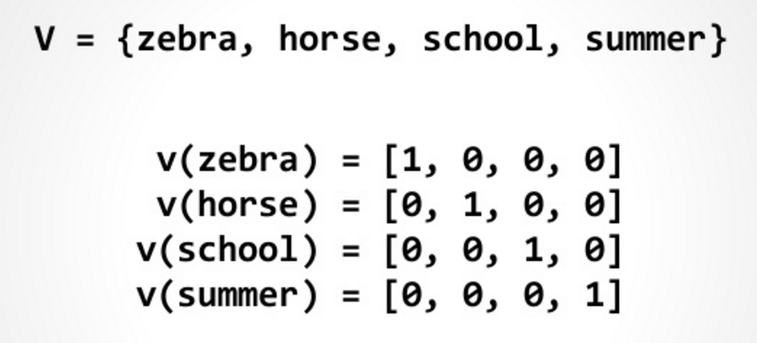
RNNs for Natural Language Processing
The natural input for a neural network is a vector of numeric values (e.g. pixel densities for imaging or audio frequency for speech recognition)
How do you feed language as input into a neural network?
The most basic solution is one hot encoding
A long vector (equal to the length of your vocabulary) where each index represents one word in the vocabulary
For each word, the index corresponding to that word is set to 1, and everything else is set to 0

Slide 21
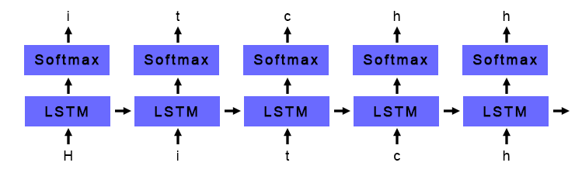
One Hot Encoding LSTM Example
Trained LSTM to predict the next character given a sequence of characters
Training corpus: All books in Hitchhiker’s Guide to the Galaxy series
One-hot encoding used to convert each character into a vector
72 possible characters – lowercase letters, uppercase letters, numbers, and punctuation
Input vector is fed into a layer of 256 LSTM nodes
LSTM output fed into a softmax layer that predicts the following character
The character with the highest softmax probability is chosen as the next character

Slide 22
Generated Samples
700 iterations: ae ae ae ae ae ae ae ae ae ae ae ae ae ae ae ae ae ae ae ae ae ae ae ae ae ae ae ae ae
4200 iterations: the sand and the said the sand and the said the sand and the said the sand and the said the sand and the said the
36000 iterations: seared to be a little was a small beach of the ship was a small beach of the ship was a small beach of the ship
100000 iterations: the second the stars is the stars to the stars in the stars that he had been so the ship had been so the ship had been
290000 iterations: started to run a computer to the computer to take a bit of a problem off the ship and the sun and the air was the sound
500000 iterations: "I think the Galaxy will be a lot of things that the second man who could not be continually and the sound of the stars

Slide 23
One Hot Encoding Shortcomings
One-hot encoding is lacking because it fails to capture semantic similarity between words, i.e., the inherent meaning of word
For example, the words “happy”, “joyful”, and “pleased” all have similar meanings, but under one-hot encoding they are three distinct and unrelated entities
What if we could capture the meaning of words within a numerical context?

Slide 24
Word Embeddings
Word embeddings are vector representations of words that attempt to capture semantic meaning
Each word is represented as a vector of numerical values
Each index in the vector represents some abstract “concept”
These concepts are unlabeled and learned during training
Words that are similar will have similar vectors
 | Masculinity | Royality | Youth | Intelligence
King | 0.95 | 0.95 | -0.1 | 0.6
Queen | -0.95 | 0.95 | -0.1 | 0.6
Prince | 0.8 | 0.8 | 0.7 | 0.4
Woman | -0.95 | 0.01 | -0.1 | 0.2
Peasant | 0.1 | -0.95 | 0.1 | -0.3
Doctor | 0.12 | 0. 1 | -0.2 | 0.95

Slide 25
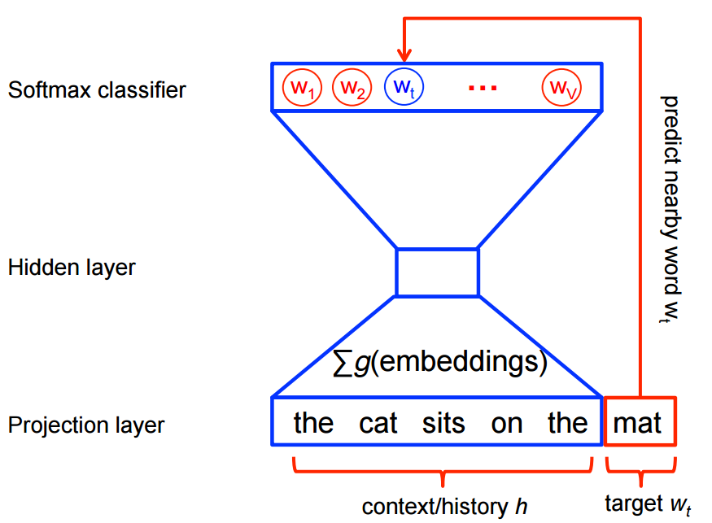
Word2Vec
Words that appear in the same context are more likely to have the same meaning
I am excited to see you today!
I am ecstatic to see you today!
Word2Vec is an algorithm that uses a funnel-shaped single hidden layer neural network to create word embeddings
Given a word (in one-hot encoded format), it tries to predict the neighbors of that word (also in one-hot encoded format), or vice versa
Words that appear in the same context will have similar embeddings

Slide 26
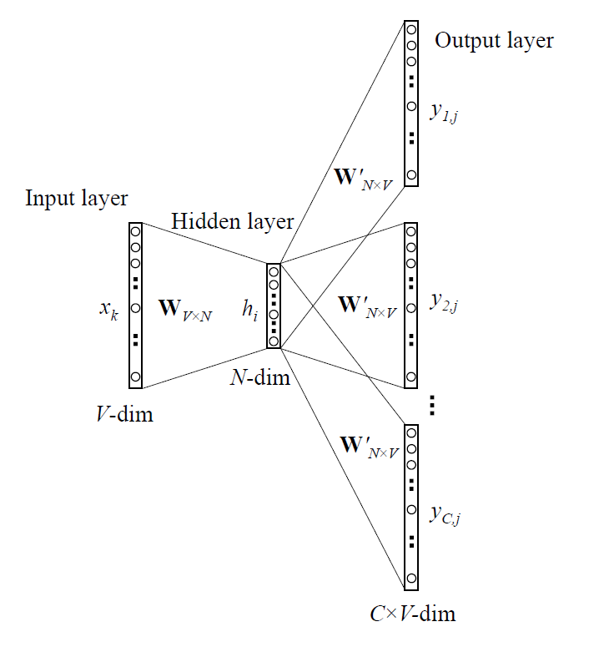
Word2Vec
The model is trained on a large corpus of text using regular backpropagation
For each word in the corpus, predict the 5 words to the left and right (or vice versa)
Once the model is trained, the embedding for a particular word is the row of the weight matrix associated with that word
Many pretrained vectors (e.g. Google) can be downloaded online

Slide 27
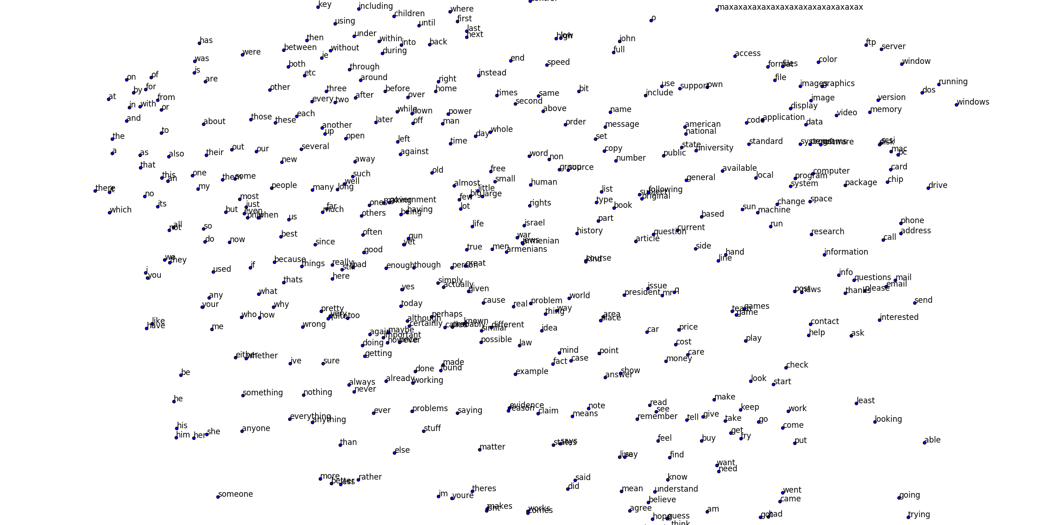
Word2Vec on 20 Newsgroups

Slide 28
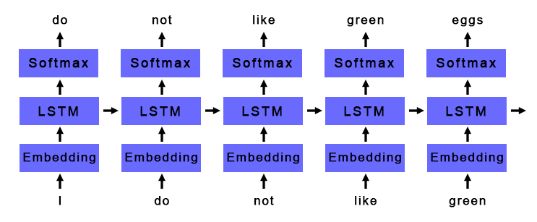
Basic Deep Learning NLP Pipeline
Generate Word Embeddings
Python gensim package
Feed word embeddings into LSTM or GRU layer
Feed output of LSTM or GRU layer into softmax classifier

Slide 29
Applications
Language Models
Given a series of words, predict the next word
Understand the inherent patterns in a given language
Useful for autocompletion and machine translation
Sentiment Analysis
Given a sentence or document, classify if it is positive or negative
Useful for analyzing the success of a product launch or automated stock trading based off news
Other forms text classification
Cancer pathology report classification

Slide 30
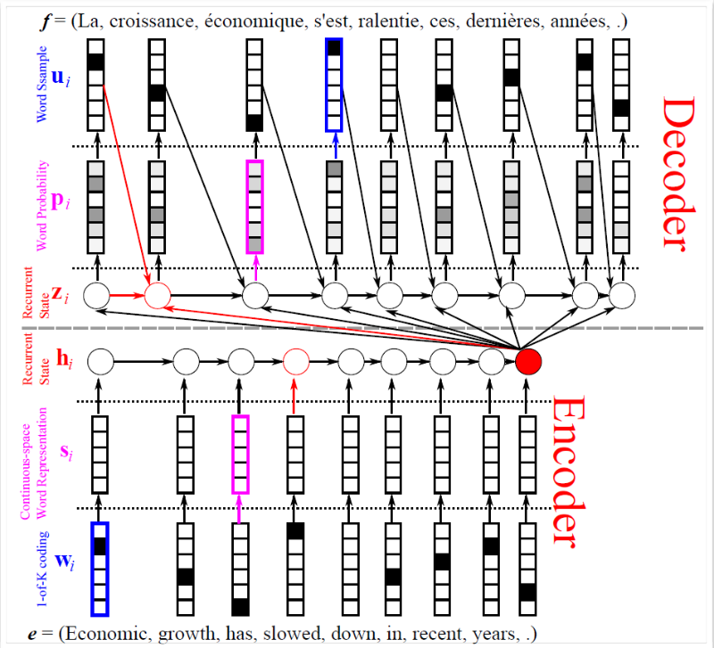
Advanced Applications
Question Answering
Read a document and then answer questions
Many models use RNNs as their foundation
Automated Image Captioning
Given an image, automatically generate a caption
Many models use both CNNs and RNNs
Machine Translation
Automatically translate text from one language to another
Many models (including Google Translate) use RNNs as their foundation

Slide 31
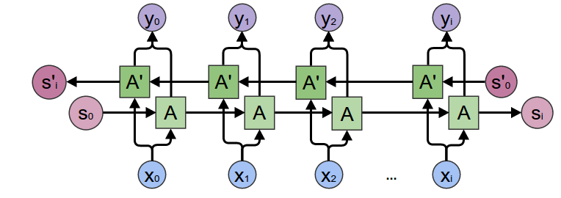
LSTM Improvements Bi-directional LSTMs
Sometimes, important context for a word comes after the word (especially important translation)
I saw a crane flying across the sky
I saw a crane lifting a large boulder
Solution - use two LSTM layers, one that reads the input forward and one that reads the input backwards, and concatenate their outputs

Slide 32
LSTM Improvements Attention Mechanisms
Sometimes only a few words in a sentence or document are important and the rest do not contribute as much meaning
For example, when classifying cancer location from cancer pathology reports, we may only care about certain keywords like “right upper lung” or “ovarian”
In a traditional RNN, we usually take the output at the last timestep
By the last timestep, information from the important words may have been diluted, even with LSTMs and GRUs units
How can we capture the information at the most important words?

Slide 33
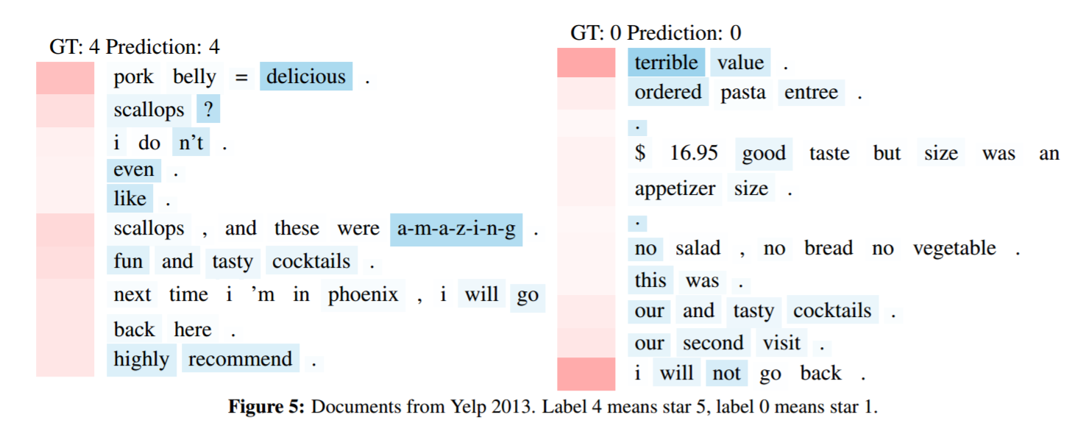
LSTM Improvements Attention Mechanisms
Naïve solution: to prevent information loss, instead of using the LSTM output at the last timestep, take the LSTM output at every timestep and use the average
Better solution: find the important timesteps, and weight the output at those timesteps much higher when doing the average

Slide 34
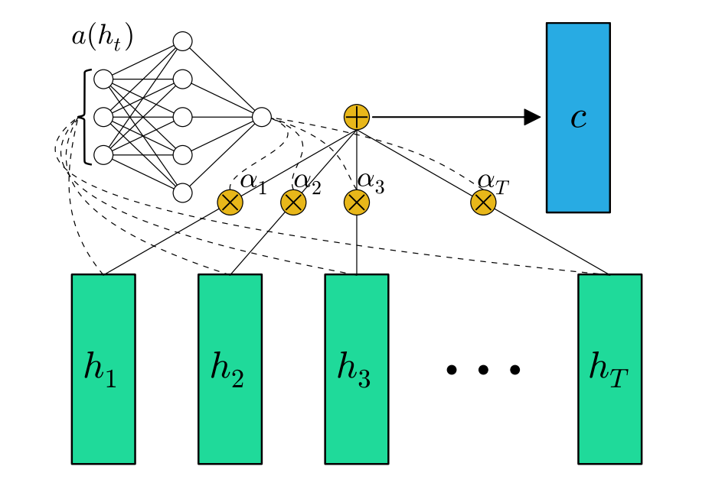
LSTM Improvements Attention Mechanisms
An attention mechanism calculates how important the LSTM output at each timestep is
It’s a simple feedforward network with a single (tanh) hidden layer and a softmax output
At each timestep, feed the output from the LSTM/GRU into the attention mechanism

Slide 35
LSTM Improvements Attention Mechanisms
Once the attention mechanism has all the timesteps, it calculates a softmax over all the timesteps
softmax always adds to 1
The softmax tells us how to weight the output at each timestep, i.e., how important each timestep is
Multiply the output at each timestep with its corresponding softmax weight and add to create a weighted average

Slide 36
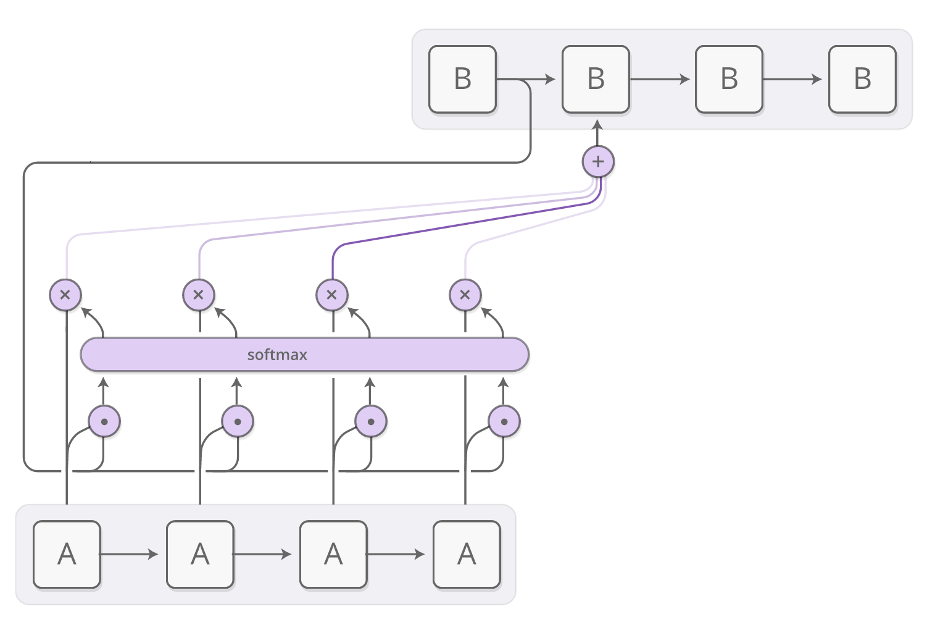
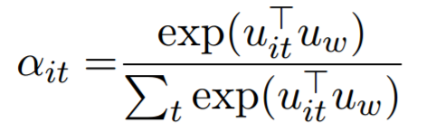
LSTM Improvements Attention Mechanisms
Attention mechanisms can take into account “context” to determine what’s important
Remember dot product is a measure of similarity – two vectors that are similar will have larger dot product
In normal softmax, dot product input with randomly initialized weights before applying softmax function

Slide 37
LSTM Improvements Attention Mechanisms
Instead, we can dot product with a vector that represents “context” to find words most similar/relevant to that context:
For question answering, can represent a question being asked
For machine translation, can represent the previous sentence
For classification, can be initialized randomly and learned during training

Slide 38
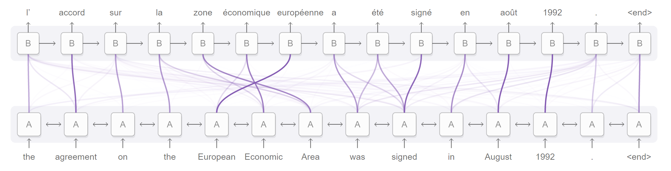
LSTM Improvements Attention Mechanisms
With attention, you can visualize how important each timestep is for a particular task

Slide 39
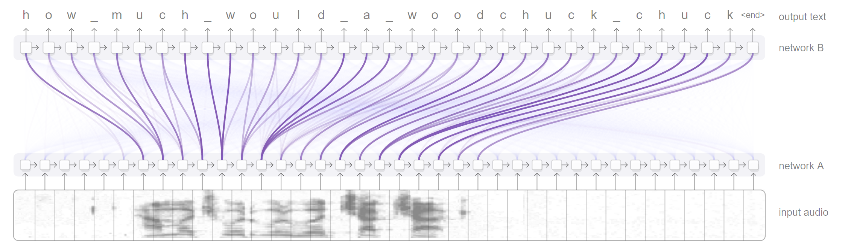
LSTM Improvements Attention Mechanisms
With attention, you can visualize how important each timestep is for a particular task

Slide 40
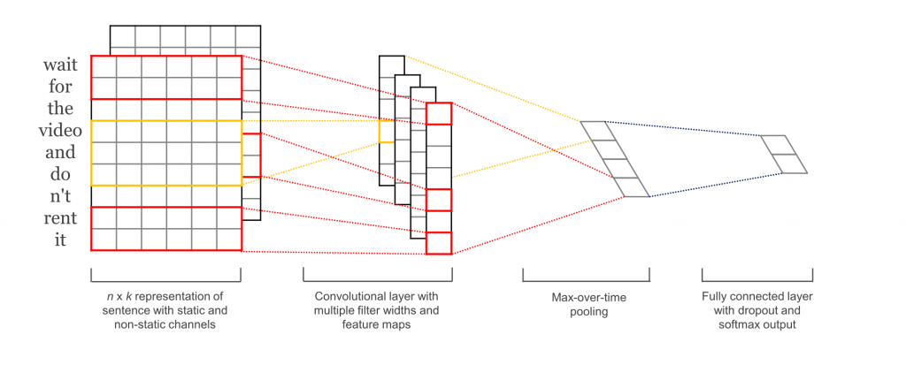
CNNs for Text Classification
3 Parallel Convolution Layers
Take in Word2Vec embeddings
Process 3, 4, and 5 words at a time
Maxpool and Concatenate
For each dimension in the convolution filters, find strongest feature across entire text
Ensures every sentence, no matter how long, is represented by same length vector
Dense and Softmax

Slide 41
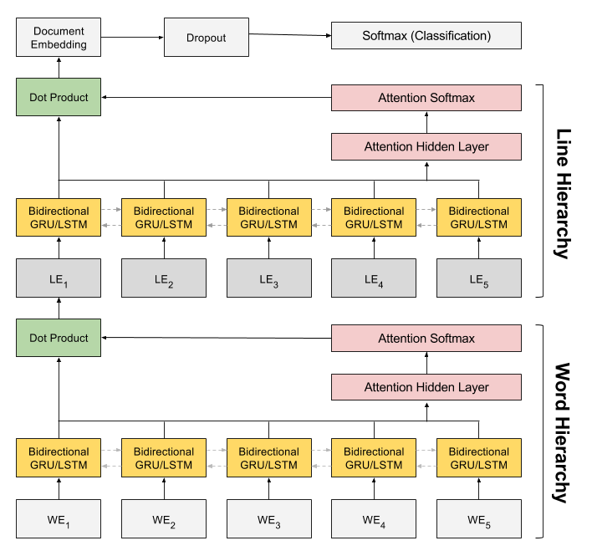
HAN Architecture
The Hierarchical Attention Network (HAN) is a deep learning model for document classification
Built from bidirectional RNNs composed of GRUs/LSTMs with attention mechanisms
Composed of “hierarchies” where the outputs of the lower hierarchies become the inputs to the upper hierarchies

Slide 42
HAN Architecture
Before feeding a document into the HAN, we first break it down into sentences (or in our case, lines)
The word hierarchy is responsible for creating sentence embeddings
This hierarchy reads in one full sentence a time, in the form of word embeddings
The attention mechanism selects the most important words
The output is a sentence embedding that captures the semantic content of the sentence based on the most important words

Slide 43
HAN Architecture
The sentence hierarchy is responsible for creating the final document embedding
Identical structure with the word hierarchy
Reads in the sentence embeddings output from the word hierarchy
The attention mechanism selects the most important sentence
The output is a document embedding representing the meaning of the entire document
The final document embedding is used for classification

Slide 44
Experimental Setup
945 cancer pathology reports, all cases of breast and lung cancer
10 – fold cross validation used, 30 epochs per fold
Hyperparameter optimization applied on models to find optimal parameters
Two main tasks – primary site classification and histological grade classification
Uneven class distribution, some with only ~10 occurrences in dataset
F-score used for performance metric
Micro F-score is weighted F-score average based on class size
Macro F-score is unweighted F-score average across all classes

Slide 45
HAN Performance Primary Site
Traditional Machine Learning Classifiers
Classifier | Primary Site Micro F-Score | Primary Site Macro F-Score
Naive Bayes | .554 (.521, .586) | .161 (.152, .170)
Logistic Regression | .621 (.589, .652) | .222 (.207, .237)
Support Vector Machine (C = 1, gamma = 1) | .616 (.585, .646) | .220 (.205, .234)
Random Forest (num trees = 100) | .628 (.597, .661) | .258 (.236, .283)
XGBoost (max depth = 5, n estimators = 300) | .709 (.681, .738) | .441 (.404, .474)
Deep Learning Classiﬁers
Recurrent Neural Network (with attention mechanism) | .694 (.666, .722) | .468 (.432, .502)
Convolutional Neural Network | .712 (.680, .736) | .398 (.359, .434)
Hierarchical Attention Network (no pretraining) | .784 (.759, .810) | .566 (.525, .607)
Hierarchical Attention Network (with pretraining) | .800 (.776,.825) | .594 (.553,.636)
12 possible cancer subsite locations
5 lung subsites
7 breast subsites
Deep learning methods outperformed all traditional ML methods except for XGBoost
HAN had best performance, pretraining improved performance even further

Slide 46
HAN Performance Histological Grade
Traditional Machine Learning Classifiers
Classifier | Histological Grade Micro F-Score | Histological Grade Macro F-Score
Naive Bayes | .481 (.442, .519) | .264 (.244, .283)
Logistic Regression | .540 (.499, .576) | .340 (.309, .371)
Support Vector Machine (C = 1, gamma = 1) | .520 (.482, .558) | .330 (.301, .357)
Random Forest (num trees = 100) | .597 (.558, .636) | .412 (.364, .476)
XGBoost (max depth = 5, n estimators = 300) | .673 (.634, .709) | .593 (.516, .662)
Deep Learning Classiﬁers
Recurrent Neural Network (with attention mechanism) | .580 (.541, .617) | .474 (.416, .536)
Convolutional Neural Network | .716 (.681, .750) | .521 (.493, .548)
Hierarchical Attention Network (no pretraining) | .916 (.895,.936) | .841 (.778,.895)
Hierarchical Attention Network (with pretraining) | .904 (.881, .927) | .822 (.744, .883)
4 possible histological grades
1-4, indicating how abnormal tumor cells and tumor tissues look under a microscope with 4 being most abnormal
Indicates how quickly a tumor is likely to grow and spread
Other than RNNs, deep learning models generally outperform traditional ML models
HAN had best performance, but pretraining did not help performance

Slide 47
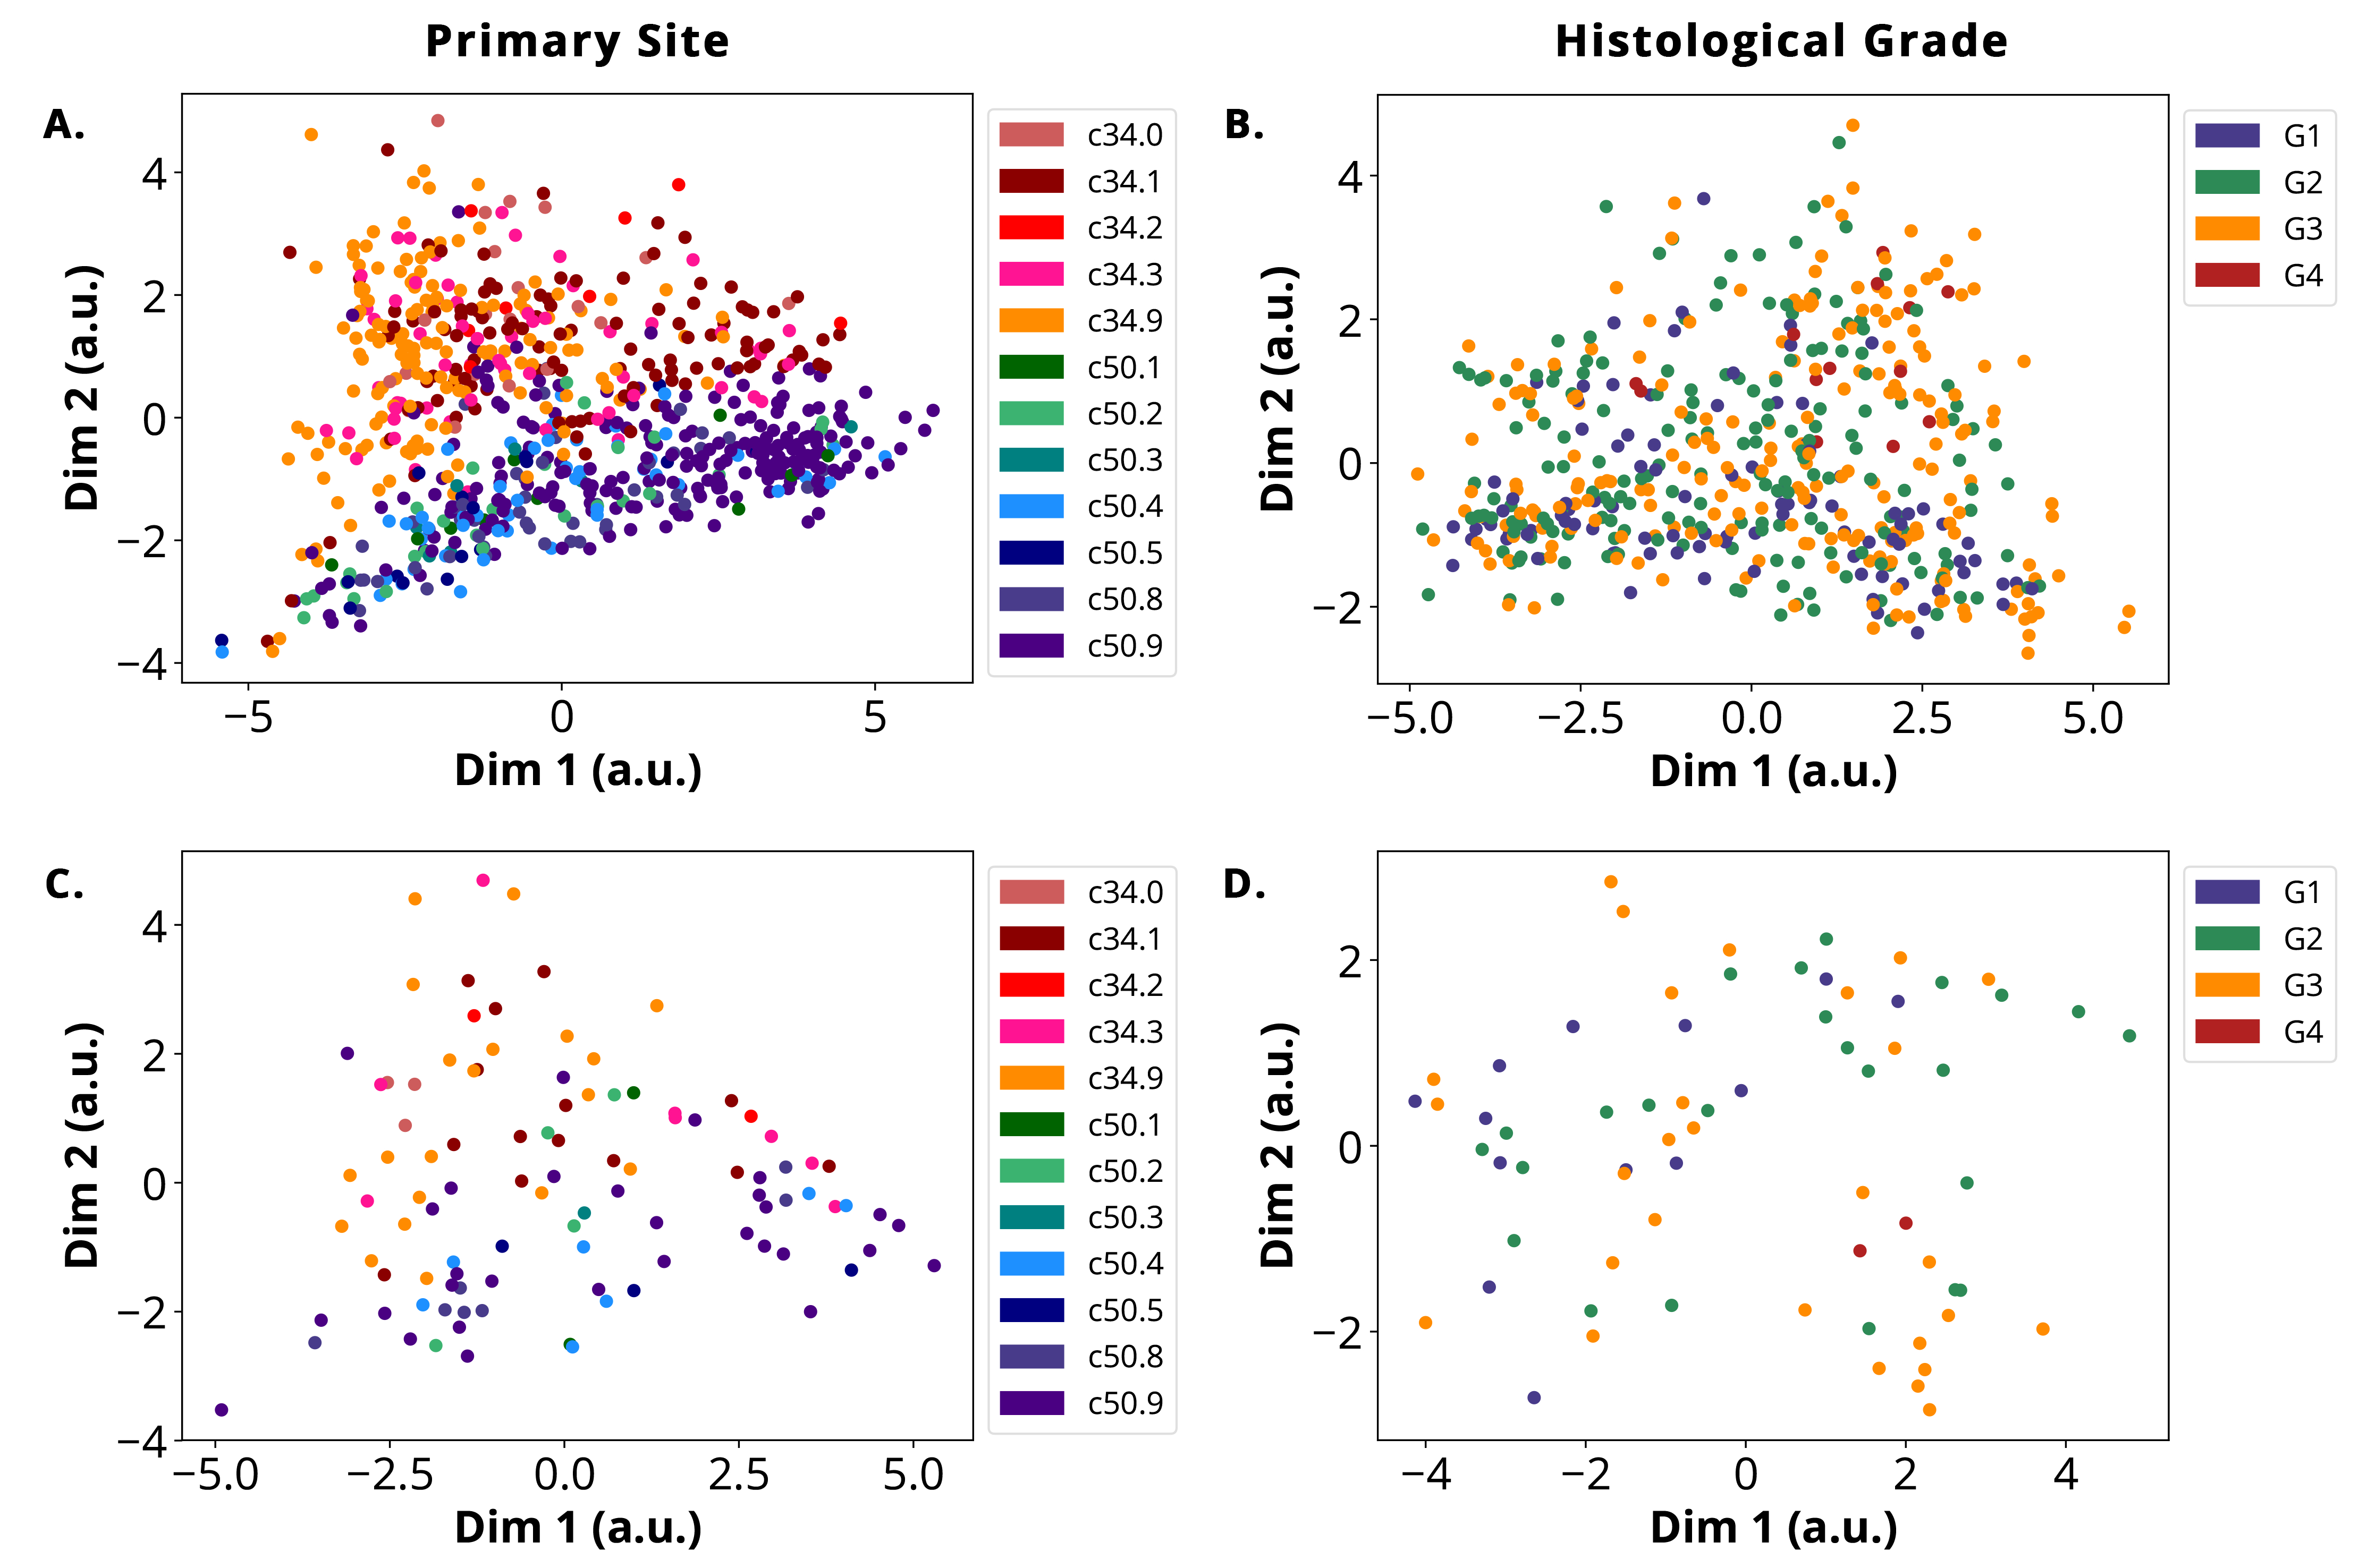
TFIDF Document Embeddings
TFIDF-weighted Word2Vec embeddings reduced to 2 dimensions via PCA for (A.) primary site train reports, (B.) histological grade train reports, (C.) primary site test reports, and (D.) histological grade train reports.

Slide 48
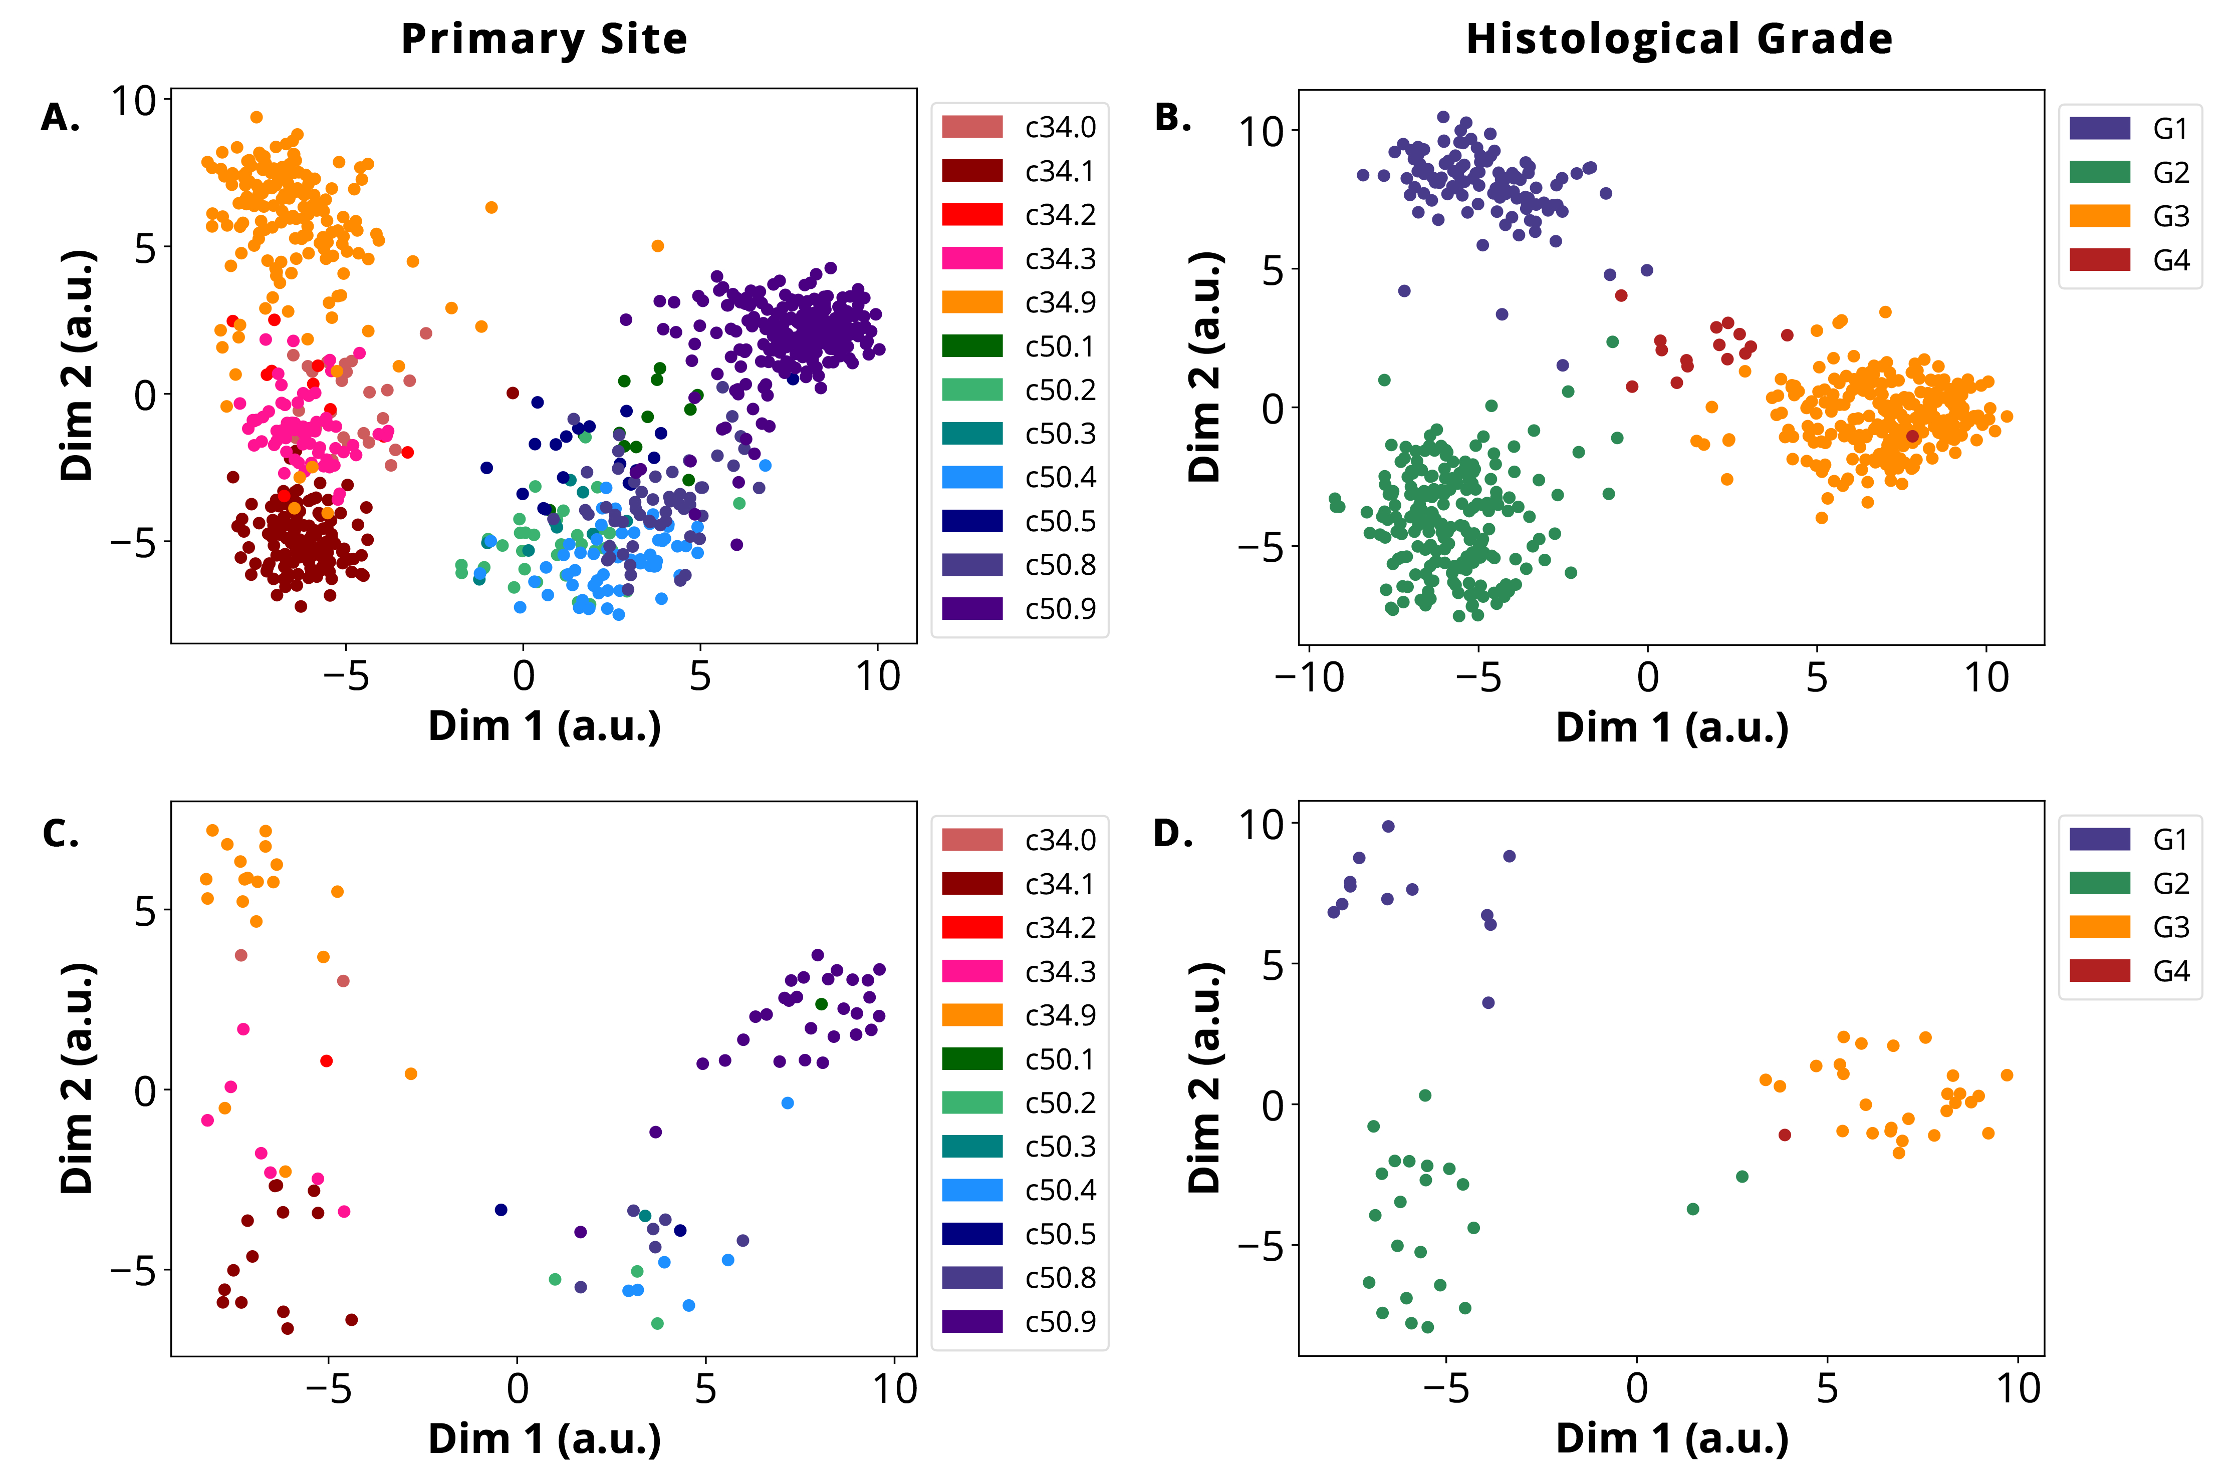
TFIDF Document Embeddings
HAN document embeddings reduced to 2 dimensions via PCA for (A.) primary site train reports, (B.) histological grade train reports, (C.) primary site test reports, and (D.) histological grade train reports.

Slide 49
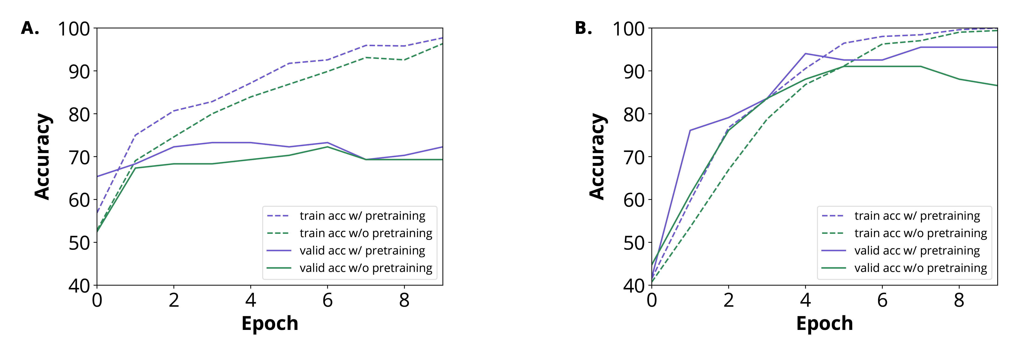
Pretraining
We have access to more unlabeled data than labeled data (approximately 1500 unlabeled, 1000 labeled)
To utilized unlabeled data, we trained our HAN to create document embeddings that matched the corresponding TF-IDF weighted word embeddings for that document
HAN training and validation accuracy with and without pretraining for (A.) primary site task and (B.) histological grade task

Slide 50
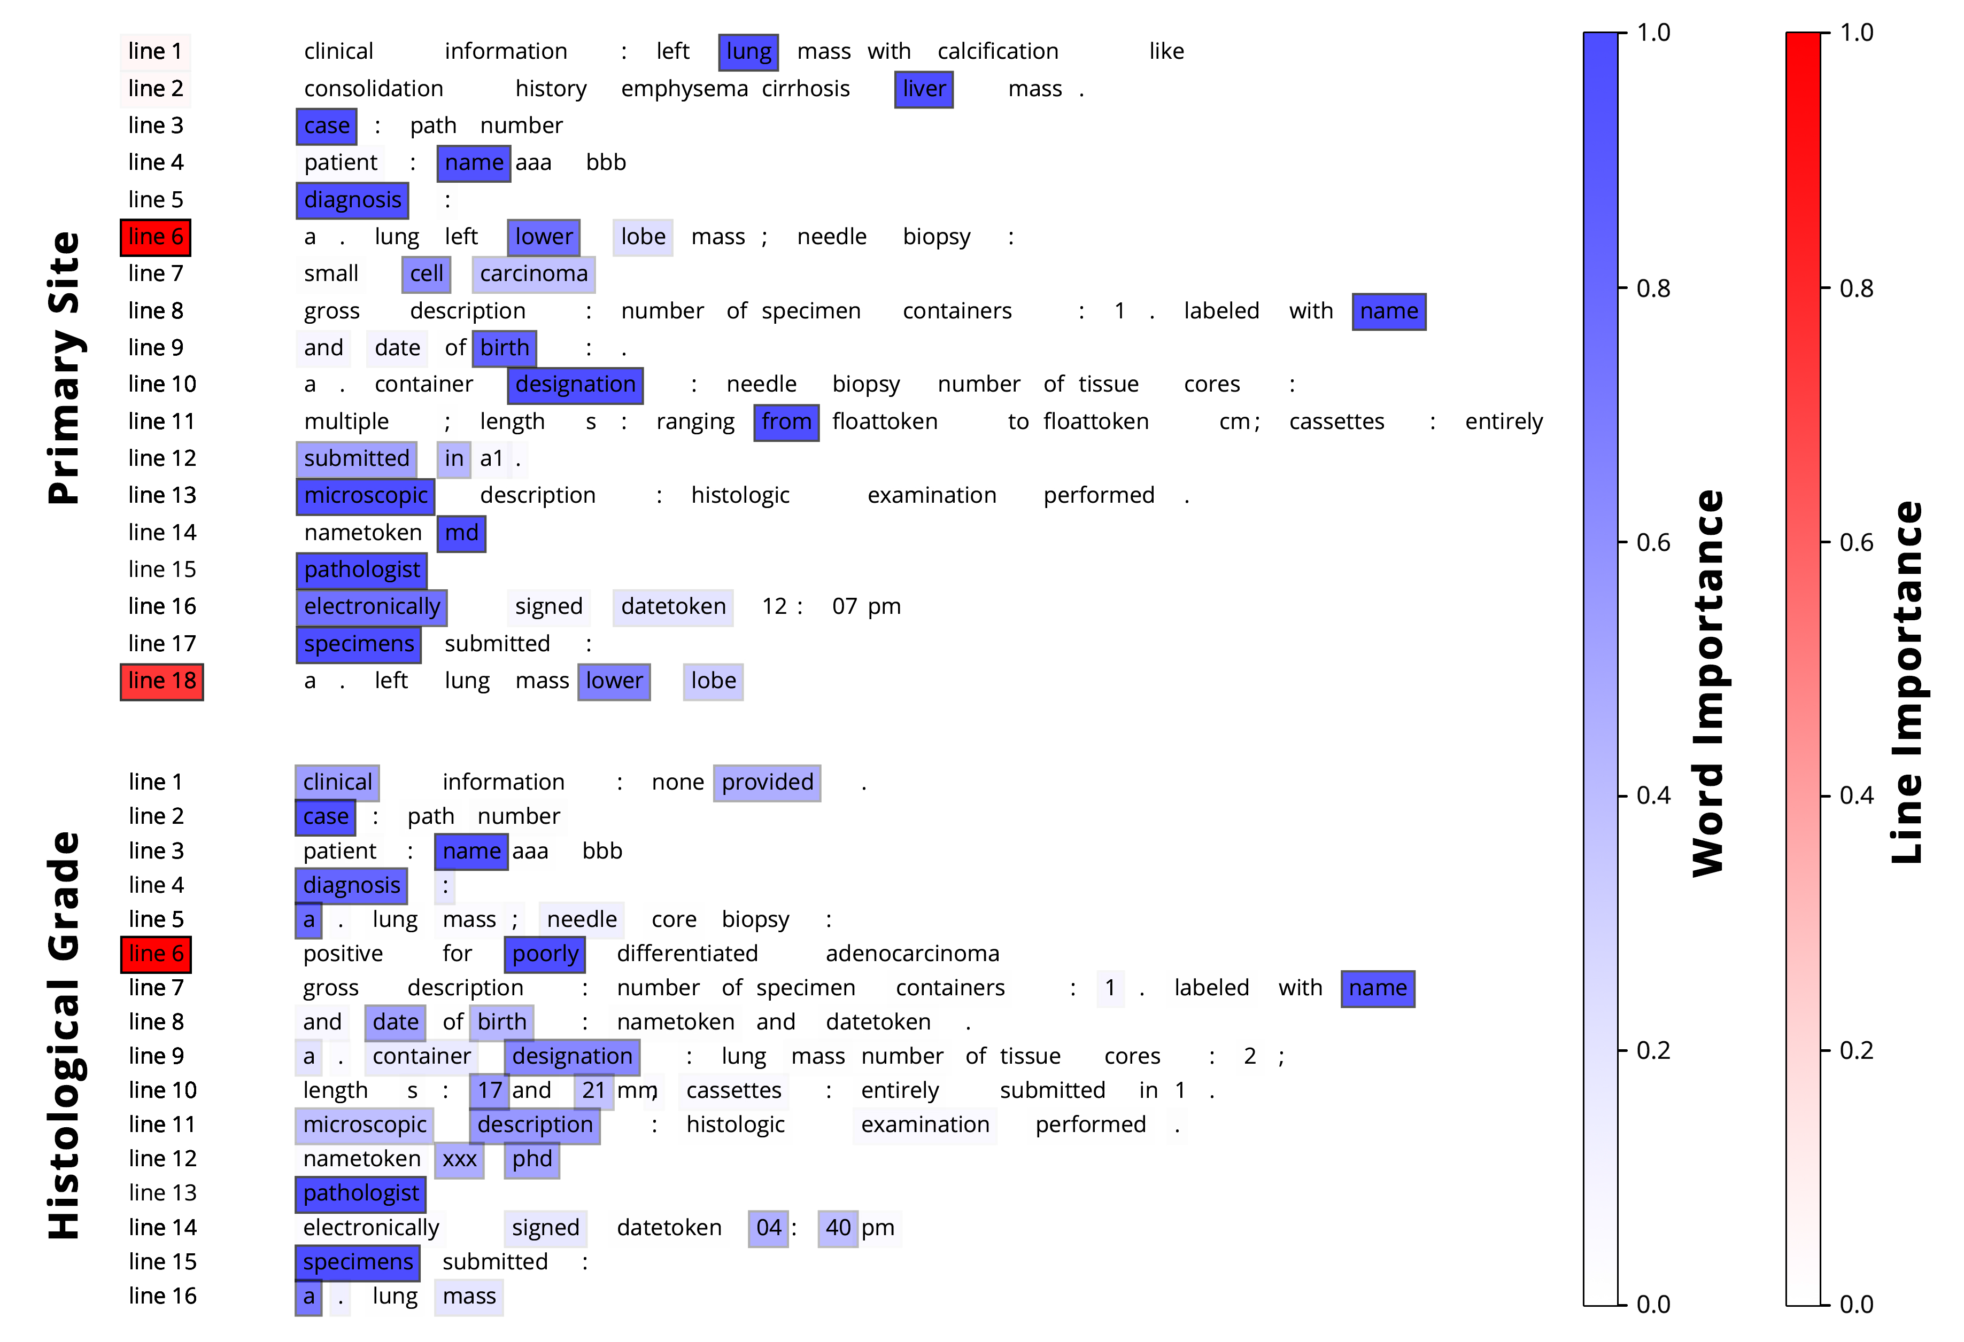
HAN Document Annotations

Slide 51
Most Important Words per Task
We can also use the HAN’s attention weights to find the words that contribute most towards the classification task at hand:
Primary Site |  |  | Histological Grade
mainstem adenoca lul lower breast | carina cusa upper middle rul | buttock temporal upper retro sputum | poorly g2 high iii dlr | Undifferentiated g3 ii i g1 | moderately intermediate well arising 2

Slide 52
Scaling
Relative to other models, HAN is very slow to train
On CPU, HAN takes approximately 4 hours to go through 30 epochs
In comparison, CNN takes around 40 minutes to go through 30 epochs, and traditional machine learning classifiers take less than a minute
The HAN is slow due to its complex architecture and use of RNNs, so gradients are very expensive to compute
We are current working to scale the HAN to run on multiple GPUs
On Tensorflow, RNNs on GPU run slower than on CPU
We are considering exploring a PyTorch implementation to get around this problem
We have successfully developed a distributed CPU-only HAN that runs on TITAN using MPI, with 4x speedup on 8 nodes

Slide 53
Attention is All You Need
New paper that came out June 2017 from Google Brain, in which they showed they could get competitive results in machine translation with only attention mechanisms and no RNNs
We applied the same architecture to replace the RNNs in our HAN
Because attention mechanisms are just matrix multiplications, it runs about 10x faster than the HAN with RNNs
This new model performs almost as well as the HAN with RNNs – 0.77 micro-F on primary site (compared to 0.78 in original HAN), and 0.86 micro-F on histological grade (compared to 0.91 in original HAN)
Because no RNNs are utilized, this model is much easier to scale on the GPU

Slide 54
Other Future Work
Multitask Learning
Predict histological grade, primary site, and other tasks simultaneously within the same model
Hopefully boost the performance of all tasks by sharing information across tasks
Semi-Supervised Learning
Utilize unlabeled data during training rather than in pretraining with the goal of improving classification performance
This task is challenging because in most semi-supervised tasks, we know all the labels within the dataset. In our case, we only have a subset of the labels.

Slide 55
Questions?

